Slide 1
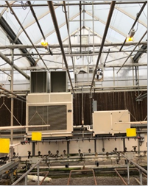
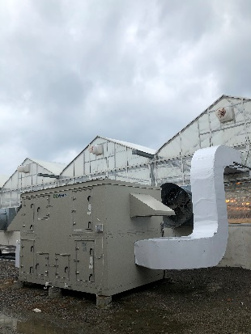
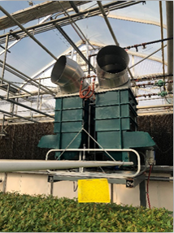
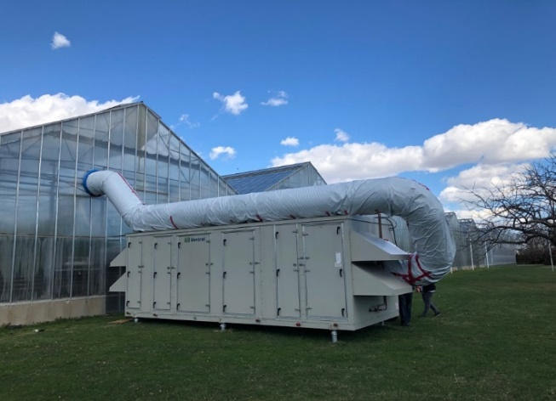
Greenhouse Dehumidification
MRD
ERV
LDD
HRV

Slide 2
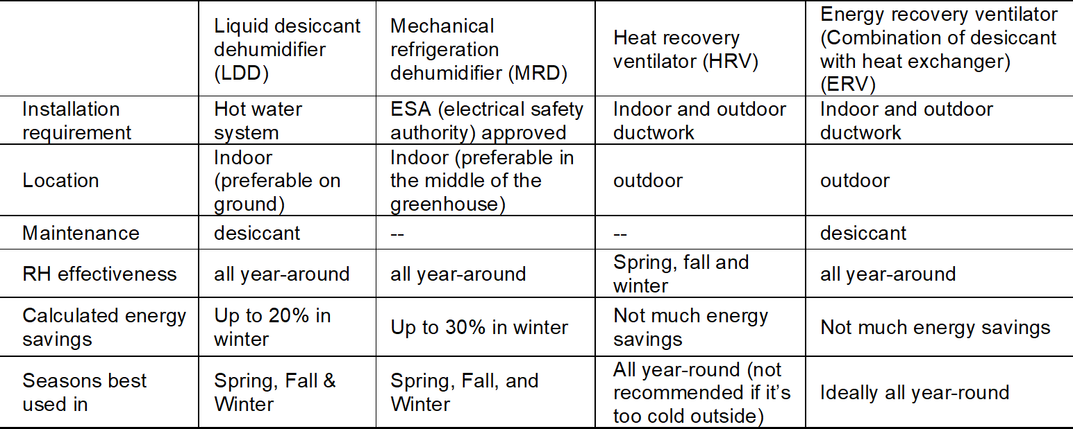
Greenhouse Dehumidification
Limitations:
1. The test zones differed in area and crop canopy size
2. The location of the units were not always ideal
3. The results were not comparable between the technologies since they were tested at different locations.
4. The greenhouses were not fully closed at night
5. The calculated energy savings are based on the collected data from the greenhouse

